Slide 1
Data Reporting Performance Measures Progress Report
Data Officer Training
April 6, 2023

Slide 2
Question 1:
Data Officer Training April 2023
The expenditures asked for in the Performance Measures refer to the spending of the Statewide Expansion of Hurrell-Harring contract (“Statewide Contract”) funds and nothing else*
True
False
* See last slide for correct answer

Slide 3
Question 2:
Data Officer Training April 2023
Each provider should submit a separate Performance Measures Progress Report to ILS*
True
False
* See last slide for correct answer

Slide 4
Question 3:
Data Officer Training April 2023
Where can County Budget Items approved in the Five-Year Statewide Contract be found?*
On the ILS website
Attachment B-1 of the Statewide Contract
Attachment C of the Statewide Contract
* See last slide for correct answer

Slide 5
Introduction
Data Officer Training April 2023
ILS-195:
- individual links sent out via email on March 1, due on April 1
- one submission per provider
- report data over calendar year 2022 (Jan 1 – Dec 31)
Performance Measures Progress Report:
- individual links sent out via email on April 3, due April 28
- one submission per provider
- report data over prior state fiscal year (Apr 1, 2022 – Mar 31, 2023)

Slide 6
We Need Accurate Data
Data Officer Training April 2023
Reporting accurate data is required under the terms of the Statewide Contract
This information is used in the annual report ILS sends to the Division of Budget on the status of implementation of Statewide reforms
Accurate Data = Continued Funding
Continued Funding = Better Representation

Slide 7
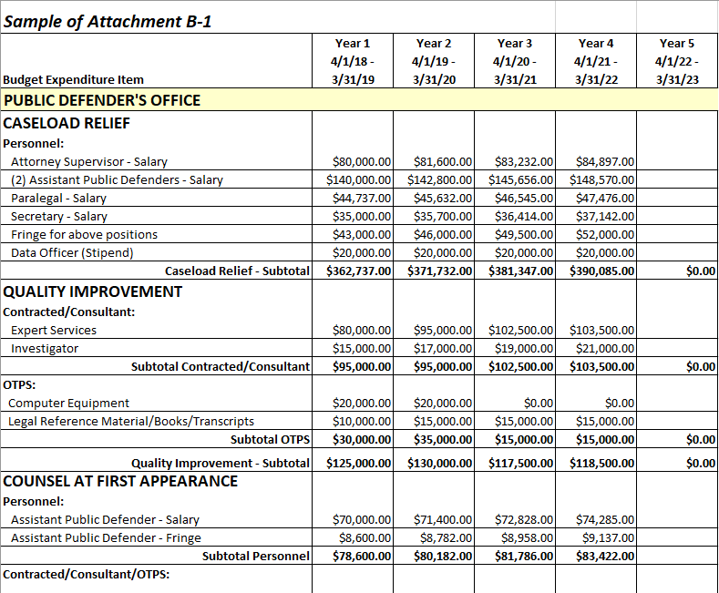
Where to Find Accurate Data: The Budget
Data Officer Training April 2023
The Budget is Attachment B-1 in the Statewide Contract
All budgets have the same format
The Budget will help you determine which positions to report and how to categorize them

Slide 8
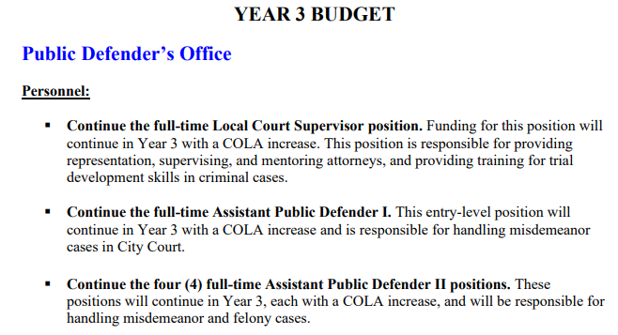
Where to Find Accurate Data: The Work Plan
Data Officer Training April 2023
The Work Plan is Attachment C of the Statewide Contract
All Work Plans have the same format and are organized by year
The Work Plan will help you categorize reported positions

Slide 9
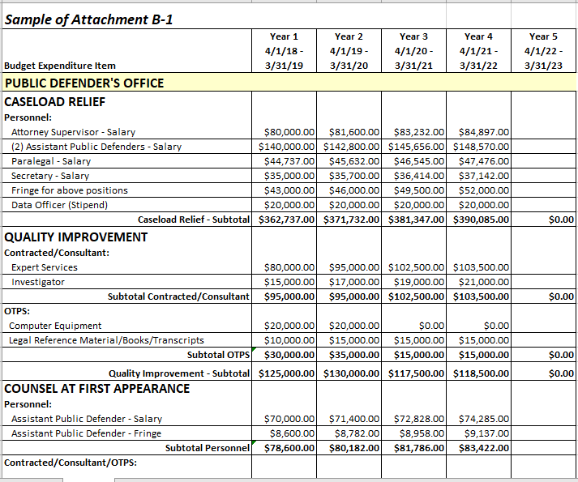
Performance Measures Question 1
Data Officer Training April 2023
Please report the number of attorney positions that are funded as of March 31, 2023 by budget expenditure items listed in the “Caseload Relief,” “Quality Improvement,” and “Counsel at First Appearance” categories of the Statewide Contract (see Attachment B-1).
Note: As this question seeks a cumulative overview of attorney positions since the implementation of the statewide reforms, answers to this question should include all attorney positions that were funded through the Statewide Contract on the last business day of the reporting period (i.e., March 31, 2023).

Slide 10
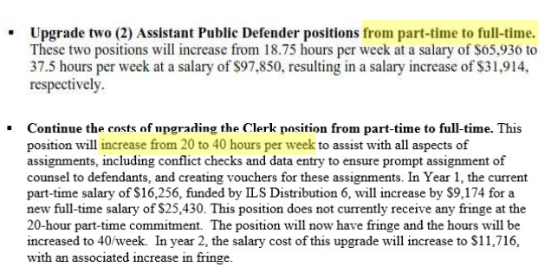
Performance Measures Question 1
Data Officer Training April 2023
The Work Plan will help determine whether a position is a “new hire,” upgrade of an existing hire.”
Look at Year 1 and all Amendments

Slide 11
Performance Measures Question 3
Data Officer Training April 2023
Please report the number of non- attorney positions that are funded as of March 31, 2023 by budget expenditure items listed in the “Caseload Relief,” “Quality Improvement,” and “Counsel at First Appearance” categories of the Statewide Contract (see Attachment B-1).
Note: As this question tries to get a cumulative overview of non-attorney positions since the implementation of the statewide reforms, answers to this question should include all non-attorney positions that were funded through the Statewide Contract on the last business day of the reporting period (i.e., March 31, 2023).

Slide 12
Question 3 vs. Question 5 (Investigators)
Data Officer Training April 2023
The difference?
Q3 is asking for “in house” positions, where the non-attorney staff position is hired/contracted to work on the cases a provider has.
Vs .
Q5 is asking for contracted services where experts and investigators are retained on a case-by case basis.
Question 3 asks you to report the total number of filled non-attorney positions, including Investigators.
Question 5 asks you to report on Experts and Investigators:
Dollar amount of retained expert services actually spent from Statewide Contract funding.
Dollar amount of retained investigative services actually spent from Statewide Contract funding.

Slide 13
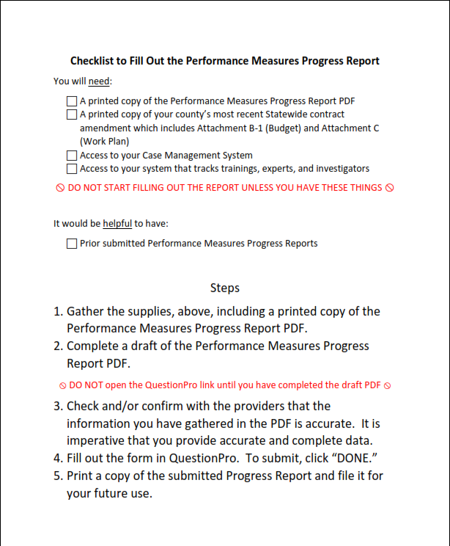
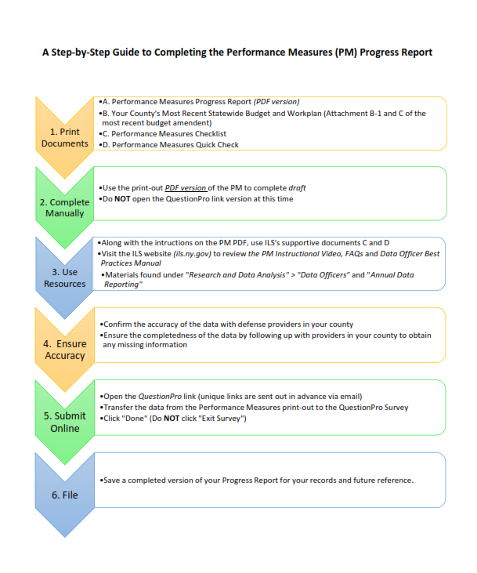
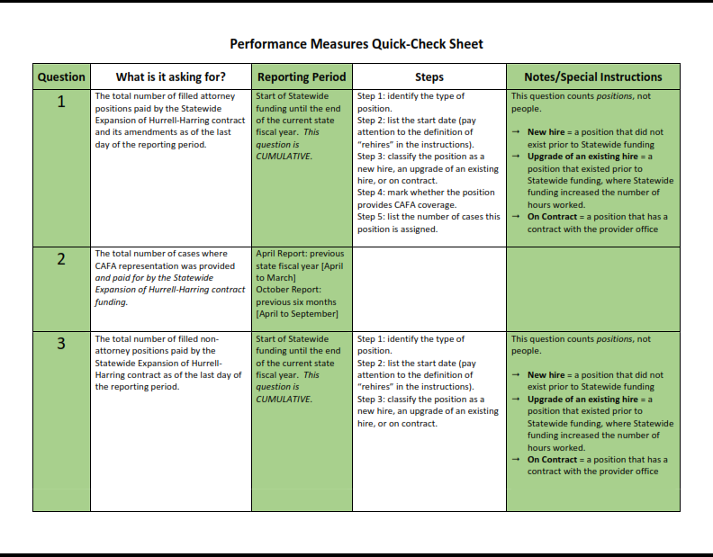
Where to Find Additional Materials? The Website!
Data Officer Training April 2023

Slide 14
How is the information used?
Data Officer Training April 2023
Annual Performance Measures Report
52 Upstate Counties and NYC, N=126 providers
Providers engaging solely in Family Court representation (n = 11) and providers from HH counties (n = 11) not included
Numbers refer to period of April 1, 2018 – March 31, 2022
Annual Performance Measures Report
Counsel at Arraignment, Caseload Relief, and Overall Quality Improvement
Numbers & qualitative info
Numbers: aggregate and per county

Slide 15
Data Officer Training April 2023
Counsel at Arraignment
The Numbers
Between April 1, 2018 and March 31, 2022, 425 new attorneys who provide counsel at arraignment were hired.
Of these, 270 were new hires, 36 were upgrades of existing positions, and 117 were contract positions.
For an estimated 101,067 cases, representation at arraignment was provided as a result of the statewide contract funding (April 1, 2021 – March 31, 2022). This is an increase of 36,580 over last year’s reported cases.

Slide 16
Data Officer Training April 2023
Caseload Relief
The Numbers
Between April 1, 2018 and March 31, 2022, 565 new attorneys were hired with the funding provided by the statewide expansion of the Hurrell-Harring settlement.
Of these, 340 were new hires, 46 were upgrades of existing positions (i.e., extra hours were added to existing part-time contracts), and 178 were placed on contract.
In total, an estimated 79,231 cases were represented by attorneys who were hired with the statewide contract funding during the period of April 1, 2021 – March 31, 2022.

Slide 17
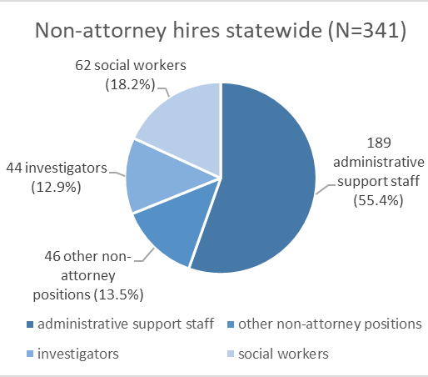
Data Officer Training April 2023
Caseload Relief
The Numbers
Additionally, between April 1, 2018 and March 31, 2022, 341 non-attorneys were hired with the statewide contract funding throughout the 52 counties and New York City.
Of these, 259 were new hires, 18 were upgrades of existing positions, and 64 were placed on contract.

Slide 18
Data Officer Training April 2023
Quality Improvement
The Numbers
Of the 565 attorney hires statewide since April 1, 2018, 73 are attorneys who supervise the work of others or provide training/mentoring.
304 training events were hosted, sponsored, or cosponsored by the statewide contract funding between April 1, 2021 and March 31, 2022.
For a total of 1,146 attorneys, their attendance at training events (such as registration fees, travel reimbursements, and accommodations) was supported by the statewide contract funding.

Slide 19
Data Officer Training April 2023
Quality Improvement
The Numbers
Statewide, a total of $830,521 was spent on contracted expert services and $367,235 was spent on contracted investigative services in the past year (April 1, 2021 – March 31, 2022).
Expert services provided as a result of statewide contract funding were used in a total of 4,011 cases.
Investigative services provided as a result of statewide contract funding were used in a total of 8,936 cases.

Slide 20
Data Officer Training April 2023
Appendix

Slide 21
Questions?
Data Officer Training April 2023
Ask us now or email performance@ils.ny.gov
Correct answers to starter questions:
Question 1: True
Question 2: True
Question 3: B

